Slide 1
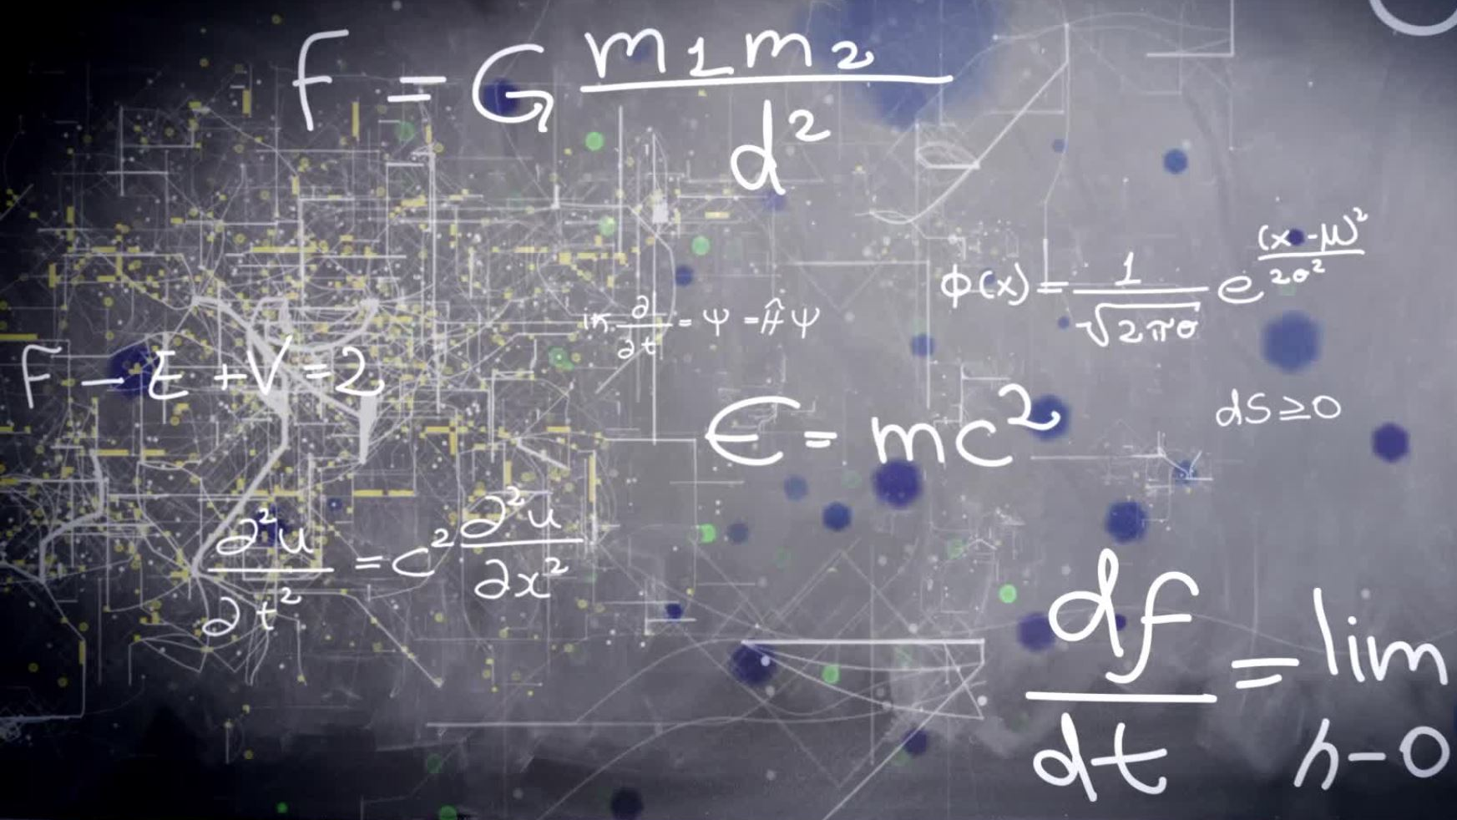
SYSTEM OF LINEAR EQUATION
CHAPTER 2

Slide 2
INTRODUCTION
Definition: Linear Equations
a1x1+a2x2+⋯+anxn=ba1x1+a2x2+⋯+anxn=b is called a linear equation in nn variables x1,x2,⋯,xnx1,x2,⋯,xn, where ai∈Rai∈R is the coefficient of xixi, for i=1,⋯,ni=1,⋯,n and b∈Rb∈R is the constant term.
x=2x=2 lis a inear equation in one variable xx.
x+y=3x+y=3 is a linear equation in two variables xx and yy.
x2+y=3x2+y=3 is not a linear equation.
Are some examples.

Slide 3
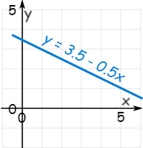
A linear equation is not always in the form y = 3.5 − 0.5x,
It can also be like y = 0.5(7 − x)
Or like y + 0.5x = 3.5
Or like y + 0.5x − 3.5 = 0 and more.
(Note: those are all the same linear equation!)
A System of Linear Equations is when we have two or more linear equations working together.
Example: Here are two linear equations:
Together they are a system of linear equations.
Can you discover the values of x and y yourself? (Just have a go, play with them a bit.)
2x | + | y | = | 5
−x | + | y | = | 2

Slide 4
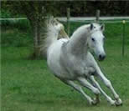
Let's try to build and solve a real world example:
Example: You versus Horse
It's a race!
You can run 0.2 km every minute.
The Horse can run 0.5 km every minute. But it takes 6 minutes to saddle the horse.
How far can you get before the horse catches you?
We can make two equations (d=distance in km, t=time in minutes)
You run at 0.2km every minute, so d = 0.2t
The horse runs at 0.5 km per minute, but we take 6 off its time: d = 0.5(t−6)
So we have a system of equations (that are linear):
d = 0.2t
d = 0.5(t−6)
We can solve it on a graph:

Slide 5
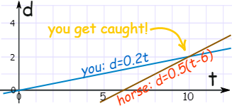
Do you see how the horse starts at 6 minutes, but then runs faster?
It seems you get caught after 10 minutes ... you only got 2 km away.
Run faster next time.

Slide 6

Linear Equations
Only simple variables are allowed in linear equations. No x², y³, √x, etc:
Linear vs non-linear

Slide 7

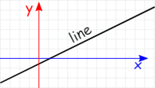
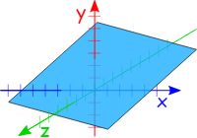
A Linear Equation can be in 2 dimensions ...
(such as x and y)
Dimensions
... or in 3 dimensions ... (it makes a plane)

Slide 8
Common Variables
For the equations to "work together" they share one or more variables:
A System of Equations has two or more equations in one or more variables
Many Variables
So a System of Equations could have many equations and many variables.
Example: 3 equations in 3 variables
2x | + | y | − | 2z | = | 3
x | − | y | − | z | = | 0
x | + | y | + | 3z | = | 12
There can be any combination:
2 equations in 3 variables,
6 equations in 4 variables,
9,000 equations in 567 variables,
etc.

Slide 9
Solutions
When the number of equations is the same as the number of variables there is likely to be a solution. Not guaranteed, but likely.
In fact there are only three possible cases:
No solution
One solution
Infinitely many solutions
When there is no solution the equations are called "inconsistent".
One or infinitely many solutions are called "consistent"

Slide 10
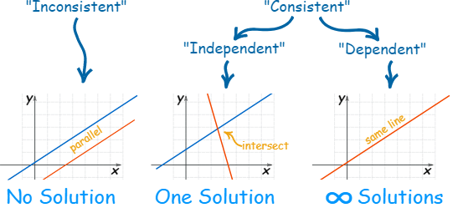
Here is a diagram for 2 equations in 2 variables:

Slide 11
The Gauss-Jordan method is similar to the Gaussian elimination process, except that the entries both above and below each pivot are zeroed out.
■
After performing Gaussian elimination on a matrix, the result is in row echelon form, while the result after the Gauss-Jordan method is in reduced row echelon form.
■
A homogeneous linear system is always consistent because it always has at least the trivial solution.
■
If a homogeneous linear system has at least one nonpivot column (for example, when it has more variables than equations), then the system has an infinite number of solutions.
■
Linear systems having the same coefficient matrix can be solved simultaneously.

Slide 12
This is to take Jacobi’s Method one step further. Where the better solution is x = (x1, x2, … , xn), if x1(k+1) is a better approximation to the value of x1 than x1(k) is, then it would better that we have found the new value x1(k+1) to use it (rather than the old value that isx1(k)) in finding x2(k+1), … , xn(k+1). So x1(k+1) is found as in Jacobi’s Method, but in finding x2(k+1), instead of using the old value of x1(k) and old values of x3(k),…, xn(k), we then use the new value x1(k+1) and the old values x3(k), … , xn(k), and similarly for finding x3(k+1), … , xn(k+1). This process to find the solution of the given linear equation is called the Gauss-Seidel Method
The Gauss–Seidel method is an iterative technique for solving a square system of n (n=3) linear equations with unknown x.
Given
Ax=B
, to find the system of equation x which satisfy this condition.
In more detail, A, x and b in their components are :

Slide 13


Then the decomposition of A Matrix into its lower triangular component and its upper triangular component is given by:
The system of linear equations are rewritten as:
The Gauss–Seidel method now solves the left hand side of this expression for x, using previous value for x on the right hand side. More formally, this may be written as:
However, by triangular form of L*, the elements of x(k+1) can be computed sequentially using forward substitution:

Slide 14
Given the three equation:
4x + y + 2z = 4
3x + 5y + z = 7
x + y + 3z = 3
First we assume that the solution of given equation is
(0,0,0)
Then first we put value of y and z in equation 1 and get value of x and update the value of x as
(x1,0,0)
Now, putting the updated value of x that is x1 and z=0 in equation 2 to get y1 and then updating our solution as
(x1,y1,0)
Then, at last putting x1 and y1 in equation 3 to get z1 and updating our solution as
(x1,y1,z1)

Slide 15

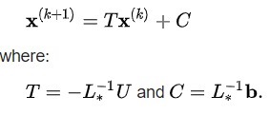
An example for the matrix version
A linear system shown as Ax=b is given by:
We want to use the equation

Slide 16


Where:
We must decompose A into the sum of a lower triangular component L* and a strict upper triangular component U:
The Inverse of L* is:

Slide 17
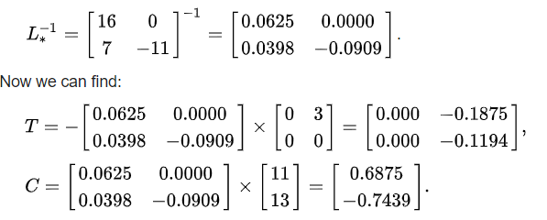
Now we can find remaining things:
Now we have T and C and we can use them to obtain the vectors x iteratively.
First of all, we have to choose x{0} we can only guess. The better the guess, the quicker the algorithm will perform.
We suppose:

Slide 18

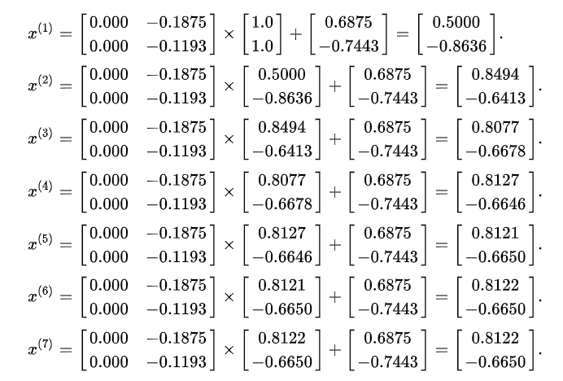
Then we can iteratively calculate other x{i’s}:

Slide 19

Now we know the Exact solution which matches the answer calculated above.
In fact, the matrix A is strictly diagonally dominant (but not positive definite).

